Slide 1
Simple Note Book
Application’s testing
Testing environment: Win11 Home (Version 21H2, Build 22000.795)
Created by:
Vytautas Uziela

Slide 2
Agenda
1. About application Simple Note Book
2. Test types
3. Smoke tests
4. Testing summary
5. Reported bugs
6. Improvements

Slide 3
1. Simple Note Book
A very simple Note book. Easy to use, fast start, no need to save.
The Camera Note feature allows you to quickly save information using camera as well as the text note.

Slide 4
2. Test types
Test types:
Functional: smoke; functionality.
Non functional: usability; compliance.

Slide 5
3. Smoke tests
1. App installation – PASSED.
2. App uninstall – PASSED.
3. Application does not crash when launched. PASSED.
4. Application does not crash when in minimized mode. PASSED.

Slide 6

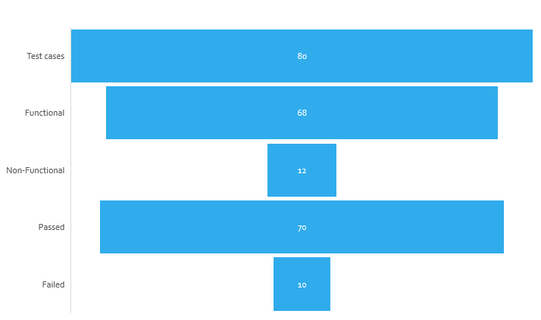

4. Testing summary

Slide 7
61 out of 68 of functional tests passed.
4 out 4 smoke tests passed.
9 out of 12 non functional tests passed.

Slide 8
5. Reported bugs
11 bugs in total were reported during application’s testing.
1 bug - Must fix
5 bugs - High priority
5 bugs - Medium priority

Slide 9
Bugs
1. "Delete notes" button is active when notes are not created. (Medium)
2. Unable to select multiple created notes . (Medium)
3. Inactive "Camera note" button. (Medium)
4 No alert pops up requesting user's confirmation regarding camera usage. (Must fix)
5. "Rotate" button does not work.(High)
6. "Share" function does not work when note is created. (High)
7. "Share" function does not work when photo note is created. (High)
8. Button "App commands" does not work.(Medium)
9. Settings menu with spelling mistake in word "Privcy“.(Medium)
10. Inactive "Simple note book" button in settings.(High)
11. Inactive arrow buttons in the camera screen. (High)

Slide 10
6. Application Simple Note Book improvements
1. Allow for the user to write or take photo note when application is launched without performing additional steps, i.e. clicking "+" button.
2. Selecting multiple notes at the same time to perform actions, i.e. Sharing, deleting. It would give less manual clicking and would save time.
3. "Share" function is on the main screen window. It would be more visible for the user and reduce additional steps and/or would save time in searching for this functionality.

